Slide 1

A PROJECT PRESENTATION
ON
Swift chat
Submitted By
Jansari Dhruvkumar Jitendrakumar ( Eno :- 22082221016 )
Patel Khushkumar Shaileshbhai ( Eno :- 22082221059 )
B.Sc.(CA&IT) - VI
U16A1PRII : INDUSTRIAL PROJECT – II Group No:- 55
Internal Guide
Ms. Kimi Modi
Submitted To
Department of Computer Science,
Ganpat University, Ganpat Vidyanagar – 384012
Academic Year 2024-2025

Slide 2
1. PROJECT PROFILE
Project Profile : | Swift chat
Objective: | The objectives of a Real-Time Chat App Web Application are to enable instant, secure, and scalable messaging with a user-friendly interface, supporting features like multi-user chats, notifications, and file sharing while ensuring cross-platform compatibility and future-readiness.
Platform of Application: | Website
Front End Tool: | React.js
Back End Tool: | node.js, Express.js, Socket.io, MongoDB
Project Duration : | 90 Days
Internal Project Guide : | Ms. Kimi Modi
Submitted By : | Jansari Dhruvkumar Jitendrakumar :-22082221016 Patel Khushkumar Shaileshbhai :-22082221059
Submitted To : | Department Of Computer Science [ B.sc ca&it - 6 ]

Slide 3
2. EXISTING SYSTEM
Limited Communication Methods -Traditional communication relies on letters, emails, and in-person conversations.
Slow Information Exchange – These methods take time to deliver messages, causing delays.
Inefficiency in Real-Time Interaction – They are not suitable for instant communication.
Lack of Accessibility – Physical letters require postage, and emails may not be checked frequently.

Slide 4
3. NEED FOR NEW SYSTEM
There is a growing need for a modern chat application to improve communication.
Instant, real-time messaging can revolutionize how people interact.
Faster and more efficient communication helps in both personal and professional settings.
A new chat system should be accessible to everyone globally.

Slide 5
4. FUNCTIONAL SPECIFICATION
4.1 USER OF THE SYSTEM
User :
Register and log in to the system.
Send and receive real-time messages.
Share files like images.
Customize their profile.
View message history and search for specific messages.
Create channels and chat with multiple users.
Chat with AI to get information and responses.

Slide 6
4. FUNCTIONAL SPECIFICATION
4.2 MODULE OF THE SYSTEM
Registration :-
The user can register on the website.
Login:-
The user and admin can login on the website.
Manage Profile:-
User can manage their own profile.
Manage chats:-
User can manage his own chats with others.
Manage Channels :-
Users can create channels with multiple users and chat with them at the same time.
Chat with AI :-
Users can receive AI-generated responses based on their queries.

Slide 7
5. SYSTEM REQUIREMENT
5.1 MINIMUM SOFTWARE REQUIREMENT
Server Side Requirement
Operating System | Window Server 2003 or Any Compatible Server OS
Web Server | Node.js with Express.js
Front-End Tools | React.js (React 18)
Back-End Tool | Node.js, Express.js, Socket.io, MongoDB
Client Side Requirement
Operating System | Window XP or Any Compatible OS
Web Browser | Google Chrome or Any Compatible Browser

Slide 8
5. SYSTEM REQUIREMENT
5.2 MINIMUM HARDWARE REQUIREMENT
Server Side Requirement
Processor | 3.0 GHz or higher
RAM | 8GB
Hard disk | 50GB SSD
Client Side Requirement
Processor | 2.5 GHz or higher
RAM | 4GB
Hard disk | 20GB free space

Slide 9
6. SYSTEM FLOWCHART

Slide 10
start
Have
an account
No
signup
Yes
Login
Join chat interface
Join Chat
Join channel
Join AI bot
Want to join Other Chat
Yes
No
Logout
End

Slide 11
7. ER-DIAGRAM

Slide 12
Manage
1
All
Messages
user
1
timestamp
1
Id
fileURL
profile Setup
Manage
id
color
sender
content
email
last name
recipents
message type
image
first name
Channels
password
id
Updated at
Name
Created at
admin
members

Slide 13
8. DATAFLOW DIAGRAM

Slide 14
8.1 ZERO LEVEL DFD

Slide 15
Login, register
Swift Chat
File transfer, chat, group chat
User
Messages
View profile, chats
Response

Slide 16
8.2 FIRST LEVEL DFD

Slide 17
FIRST LEVEL DFD USER SIDE
User
Username, Email ,password
Registration
Check for Registration
User
Registration success
Response
Email ,password
Login
Check for Login
User
login success
Response
First name, last name, image, Email
Manage Profile
Check for Profile
User
Profile Update success
Response
Message, file transfer, delete
Manage Message
Check for Chats
Message
Message success
Response
Send Messages to users
Manage channels / groups
Check for Chats
channels
Message success
Response

Slide 18
9. DATA DICTIONARY
TABLE NAME
Users
Messages
Channels

Slide 19
User
Table Name : - | Users
Primary Key : - | Id
Foreign Key : - | -
Description : - | To store user information
Sr. No | Field Name | Data Type (Size) | Constraint | Description | Sample Data
1 | id | object | Primary key | Store Primary key | 5654fgcfc4dx89g4
2 | email | string | Required | Store email | raja@gmail.com
3 | password | string | Required | store password | Raj@956
4 | firstname | string | Required | store First Name | Patel
5 | lastname | string | Required | Store Last Name | Raj
6 | image | string | Required | Store image | user_img.jpg
7 | colour | number | Required | Store Colour | 3
8 | profile setup | Boolean | Required | Store Profile setup | true

Slide 20
Messages
Table Name : - | Messages
Primary Key : - | Id
Foreign Key : - | -
Description : - | To store user information
Sr. No | Field Name | Data Type (Size) | Constraint | Description | Sample Data
1 | id | object | Primary Key | Store id | 56164421497121
2 | sender | object | Required | Store object id of sender | 587468j6848615
3 | recipient | object | Required | Store object id of recipient | 1654685168h546
4 | messageType | string | Required | Store message type | text
5 | content | string | Required | Store message content | Hello!
6 | fileUrl | string | Required | Store fileurl | Upload/files/img.png
7 | timeStamp | date | Required | Store date and time | 2024-07-06T14:50:13

Slide 21
Channels
Table Name : - | Users
Primary Key : - | Id
Foreign Key : - | -
Description : - | To store user information
Sr. No | Field Name | Data Type (Size) | Constraint | Description | Sample Data
1 | id | object | Primary key | Store Primary key | 5654fgcfc4dx89g4
2 | name | string | Required | Store name | raja
3 | admin | object | Required | Store channel admin id | 67d91940a172460ea797dcf8
4 | members | object | Required | store members id | a172460ea797dcf867d91940
5 | messages | object | Required | Store messages | hello
6 | createdAt | Date | - | Store date | 2025-03-18T06:03:48.946
6\7 | updatedAt | Date | - | Store date | 2025-03-18T06:03:48.946

Slide 22
10. OUTPUT DESIGN

Slide 23
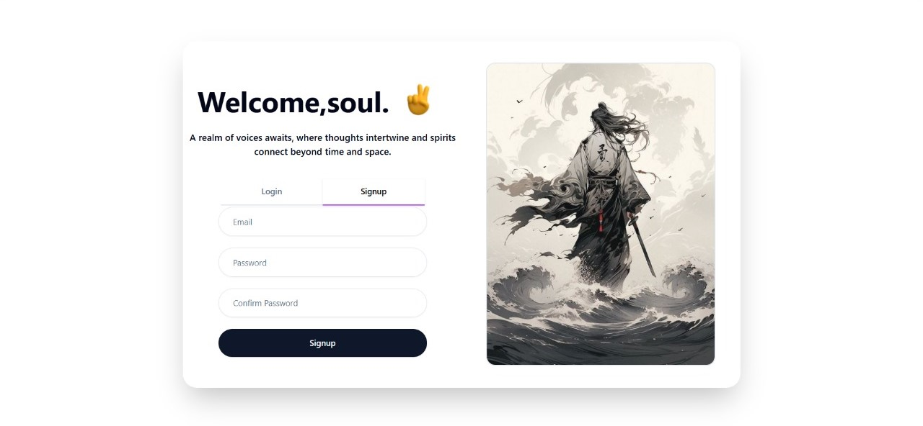
Signup page :- A page where users can create an account to access the website.

Slide 24
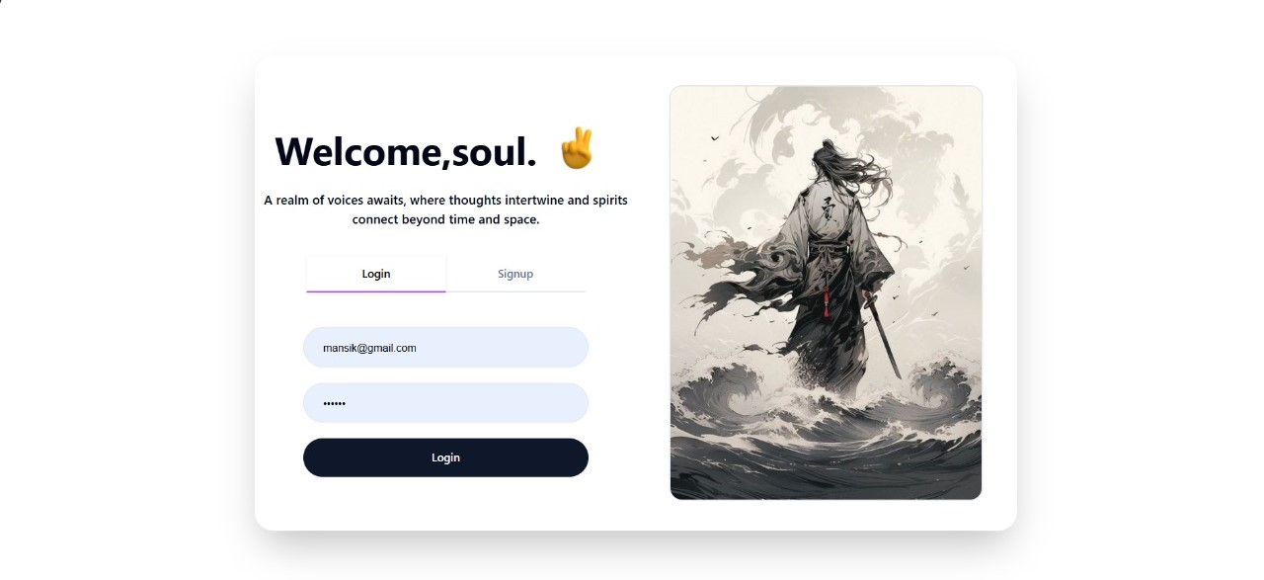
Login page :- A page where users can log in to access the website.

Slide 25
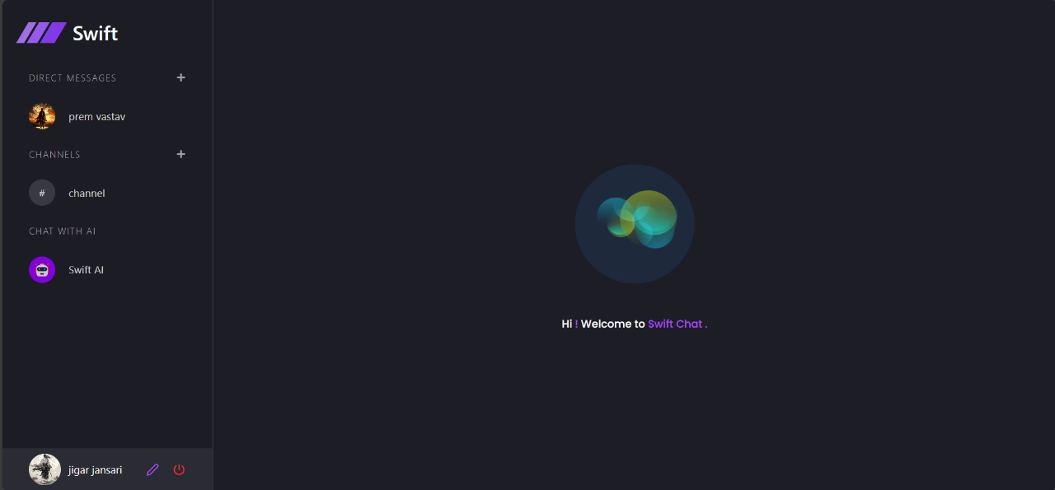
Website Interface

Slide 26
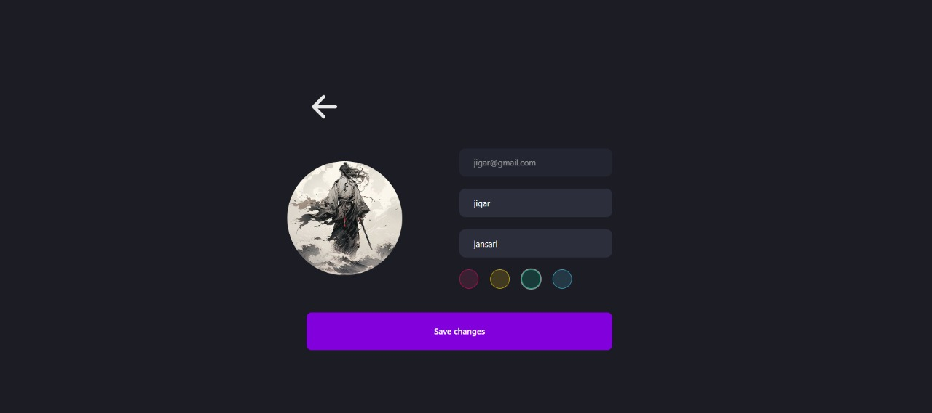
Profile Update Page :- A page where users can update their profile information.

Slide 27
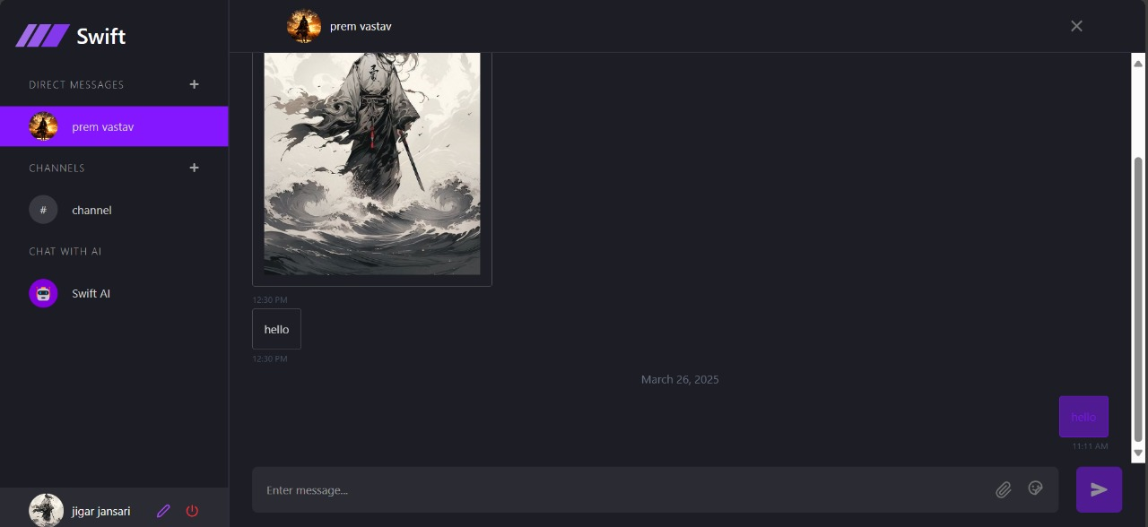
Chat Container :- A section where users can send and receive messages in real-time.

Slide 28
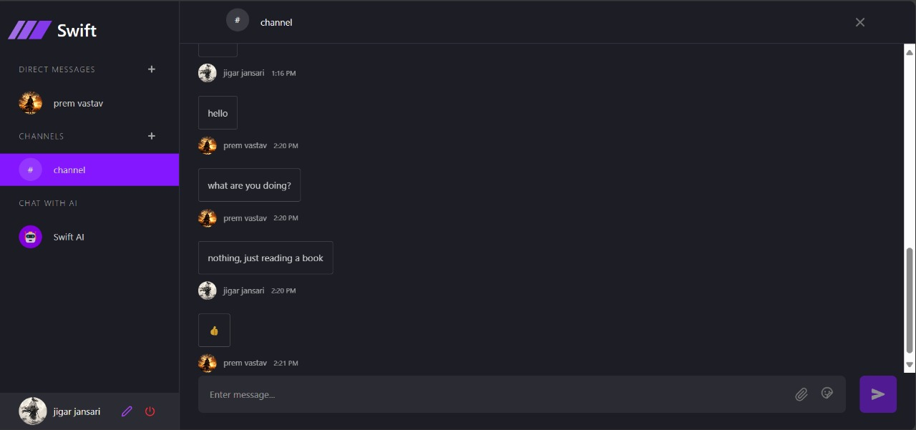
Channel Container :- A section where users can send messages to multiple users and receive messages from them in real-time.

Slide 29
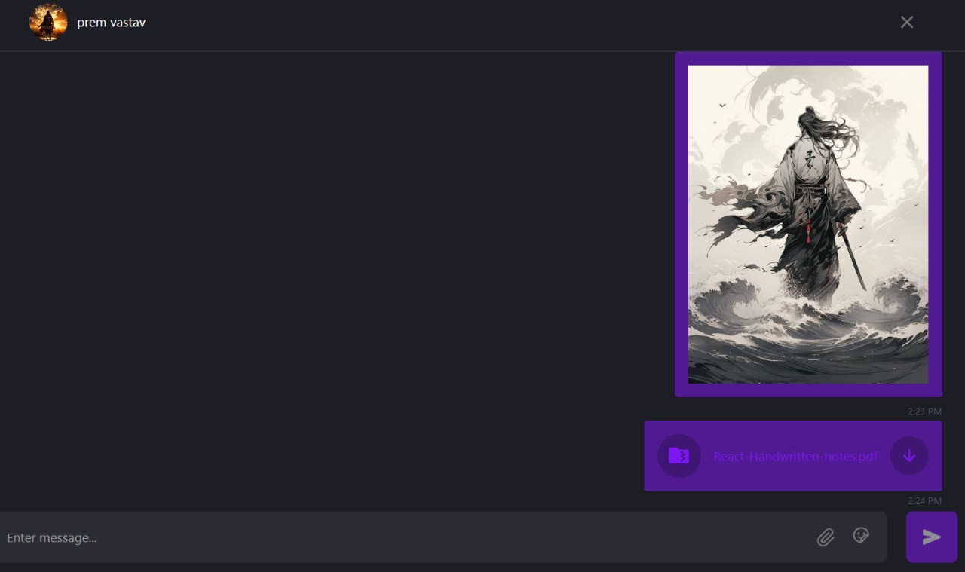
Document Sharing :- Users can send and receive documents in chat.
Users can also download shared documents directly from the chat.

Slide 30
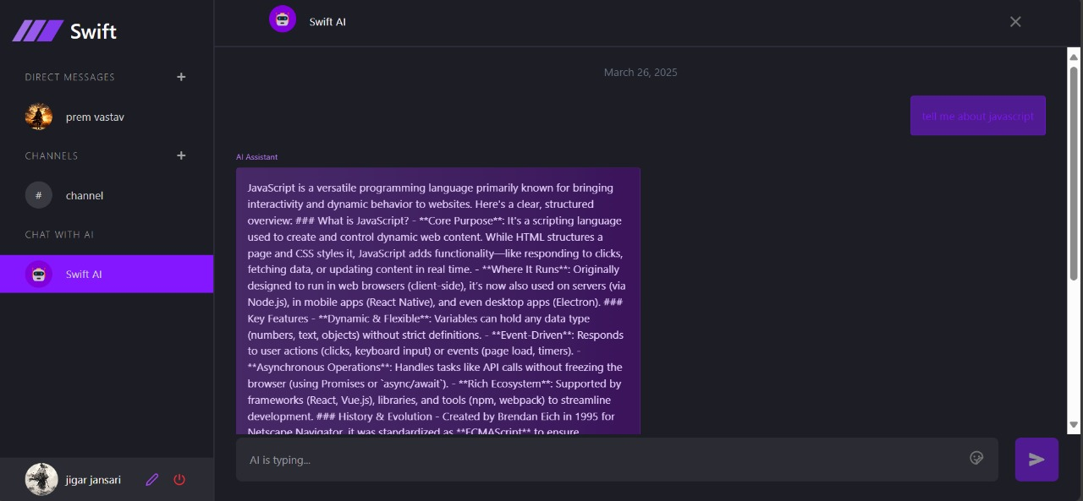
AI Container :- A section where users can send queries and receive AI-generated responses in real-time.

Slide 31
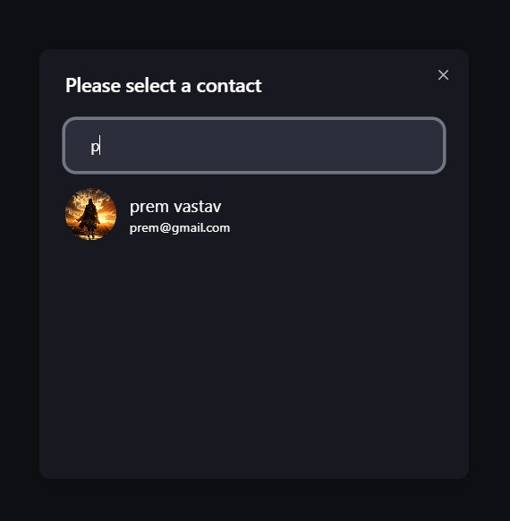
Contact Selector :- Allows users to select a person and start a one-on-one chat.

Slide 32
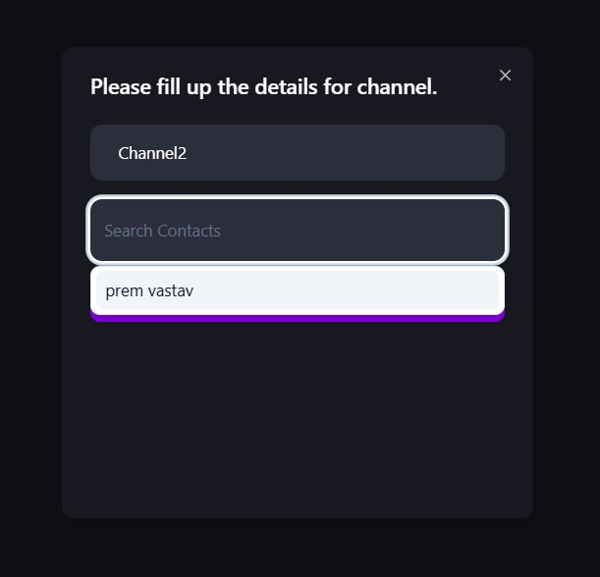
Channel Creator Container :- A section where users can create new channels and add multiple participants for group chats

Slide 33
11. TESTING
No. | Test Condition | Description | Expected Result | Actual Output | Status
1 | Registration | Click on submit button without Email | System will display validation message | System display message like “email are required” | Pass
 |  | Click on submit button without password | System will display validation message | System display message like “Enter password” | Pass
 |  | Click on submit button without Confirm password | System will display validation message | System display message like “Enter confirm password” | Pass
 |  | Click on signup button with valid email and password | System will allow to signup | System will display validation message like “signup successful” | Pass

Slide 34
No. | Test Condition | Description | Expected Result | Actual Output | Status
2 | Login | Non-Registered user | System will not allow Non-Registered user to login | System will display validation message like “Can’t find user” | Pass
 |  | Click on login button with invalid email and password | System will not allow user to login | System will display validation message like “Invalid login details” | Pass
 |  | Click on login button with valid email and password | System will allow to login | System will display validation message like “Login successful” | Pass

Slide 35
12. FUTURE ENHANCEMENT
I will provide google authentication facility, so user can sign up through google account.
Displays the number of messages received and the count of active users on the website in real time.
Notifies users of new messages, mentions, and channel updates.
users will be able to create and share posts within personal feeds.
Voice and video calling features will be introduced to enable real-time communication also.

Slide 36
13. BIBLIOGRAPHY
For developing this “Royal fitness Gym Website” I have referred the following website:
https://ui.shadcn.com/
https://tailwindcss.com/docs/installation/using-vite
https://openrouter.ai/

Slide 37
THANK YOU

